Slide 1

+++ Live +++ +++ Live +++ +++ Live +++
Welcome
to
Software Engineering
Lesson WS2021/2022
Starting at 14:15

Slide 2

+++ Live +++ +++ Live +++ +++ Live +++
The rule No1
Keep your camera on

Slide 3

+++ Live +++ +++ Live +++ +++ Live +++
Software Engineering
WS-2020-2021
Lesson Mo. 14.15-17.45 h Lab: Thur. 14.00-16.00 h
Room 8-103
https://www.linkedin.com/groups/8689804/

Slide 4


Who am I?
Damir Dobric
Microsoft PTSP (Partner Technical Solution Specialist) Microsoft Most Valuable Professional
Blog
Twitter
damir.dobric@daenet.com b-dadobr@microsoft.com
https://damirdobric.me

Slide 5
+++ Live +++ +++ Live +++ +++ Live +++
.NET / C#

Slide 6
AGENDA
What is .NET Core?
Why .NET Core?
Supported platforms
Not supported platforms

Slide 7
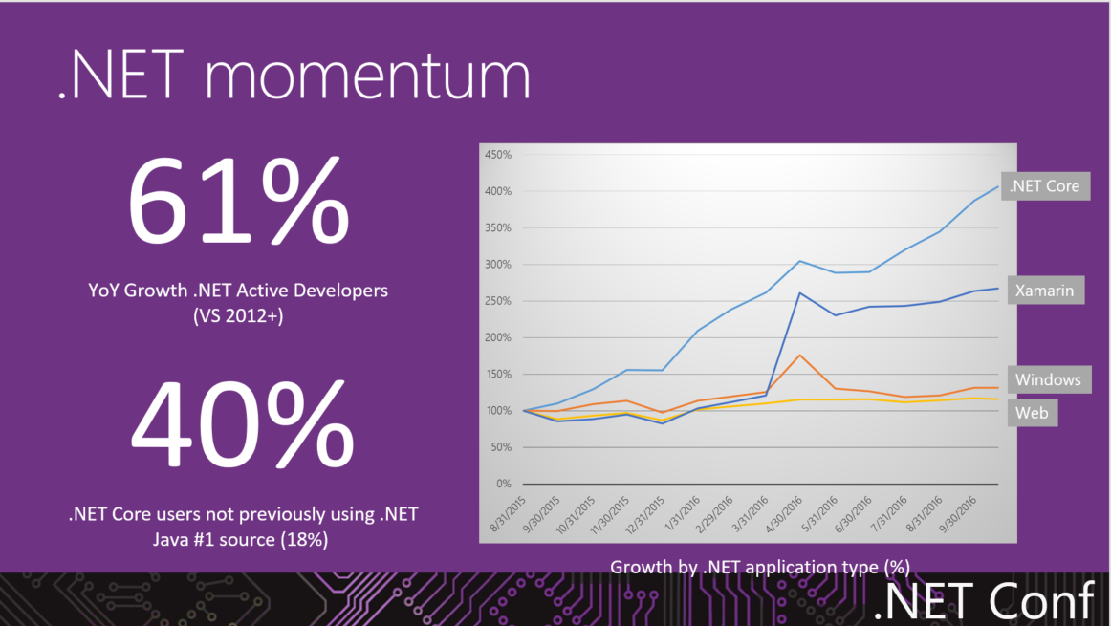

Slide 8
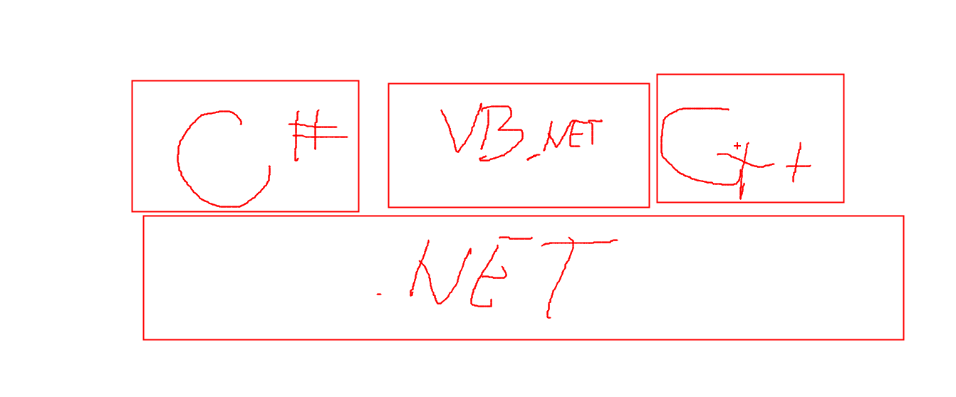

Slide 9
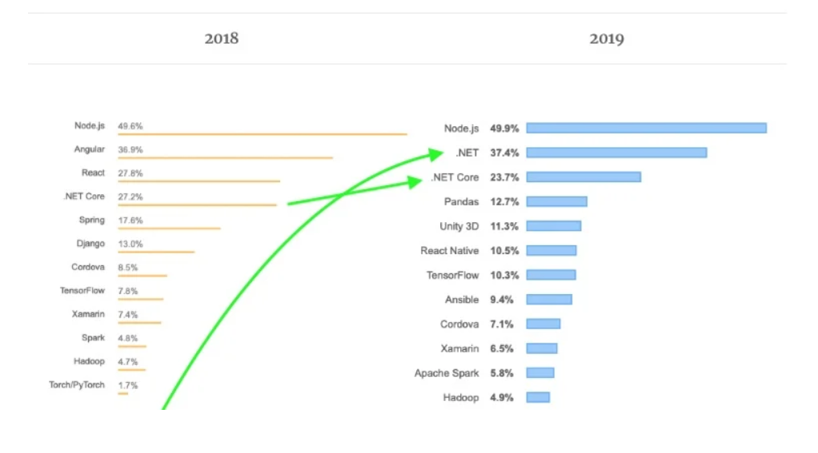
https://insights.stackoverflow.com/survey/2021

Slide 10
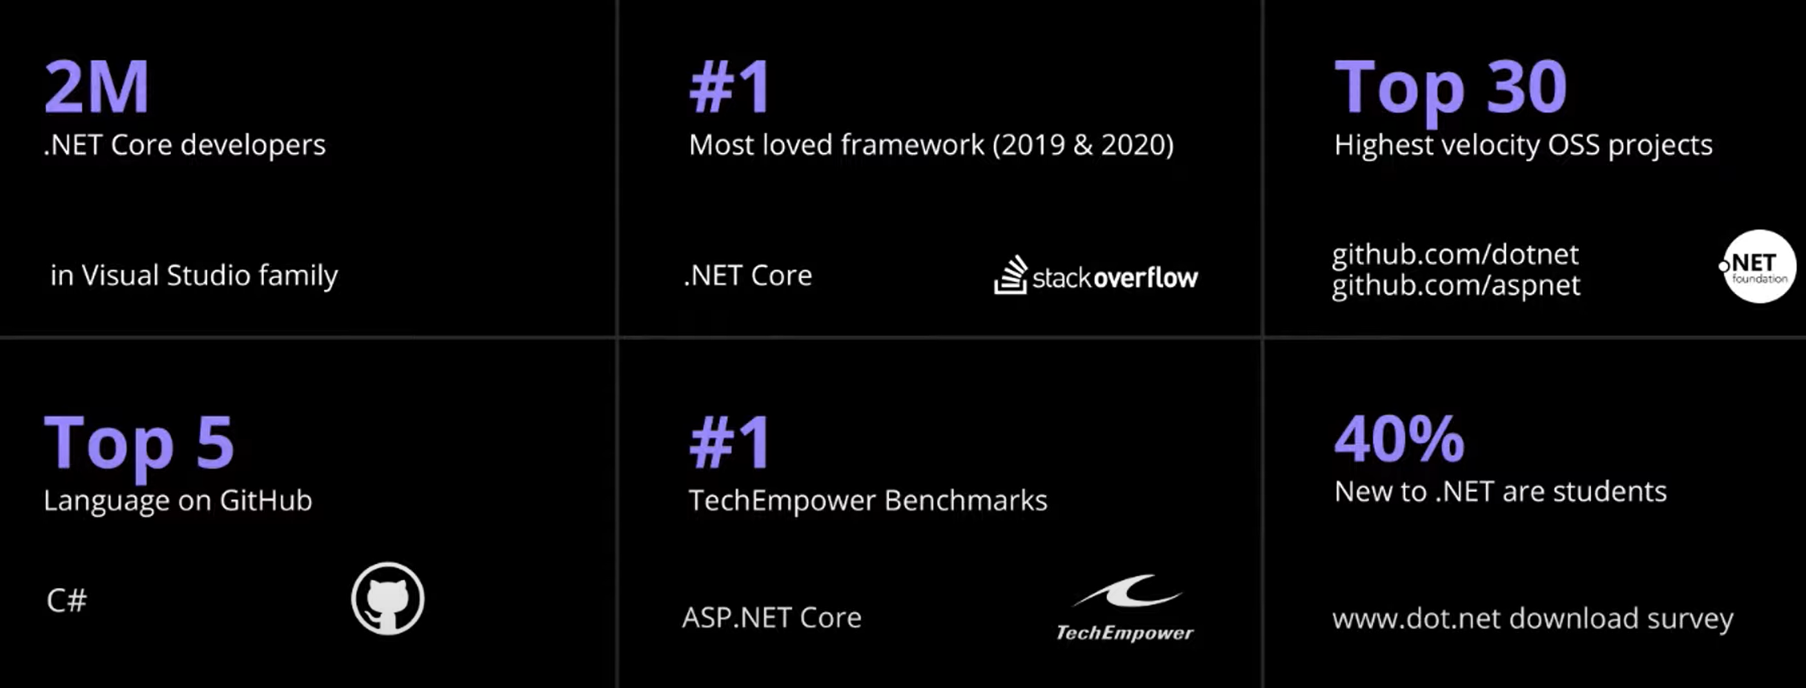

Slide 11
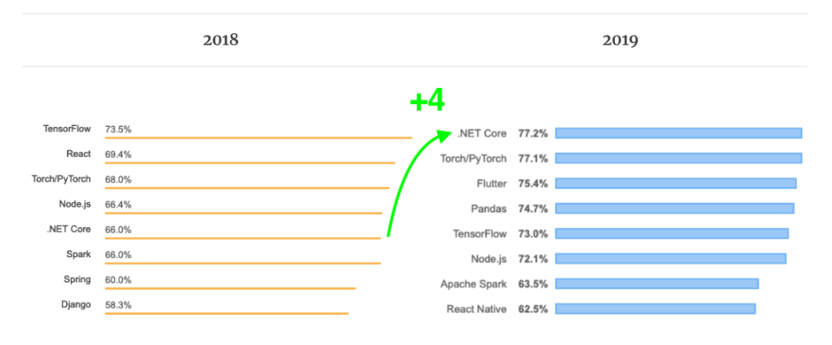
Most loved source: stack overflow
Stack Overflow Developer Survey 2022
https://codinginfinite.com/stack-overflow-developers-survey-2019-vs-2018-technology-comparison/

Slide 12
Statically Typed or Not?
Java Script/Node.JS
var a = “Hello”;
var b = 7;
a = 8;
var c = a + b; // “Hello 7” 8
C#/JAVA
var a = “Hello”;
var b = 7;
// Compiler Error
var c = a + b; // “Hello 7” 8

Slide 13
Good to know source: stack overflow
https://insights.stackoverflow.com/survey/2021
https://survey.stackoverflow.co/2022/#technology

Slide 14
Learning C#
https://www.microsoft.com/net/tutorials/csharp/getting-started

Slide 15
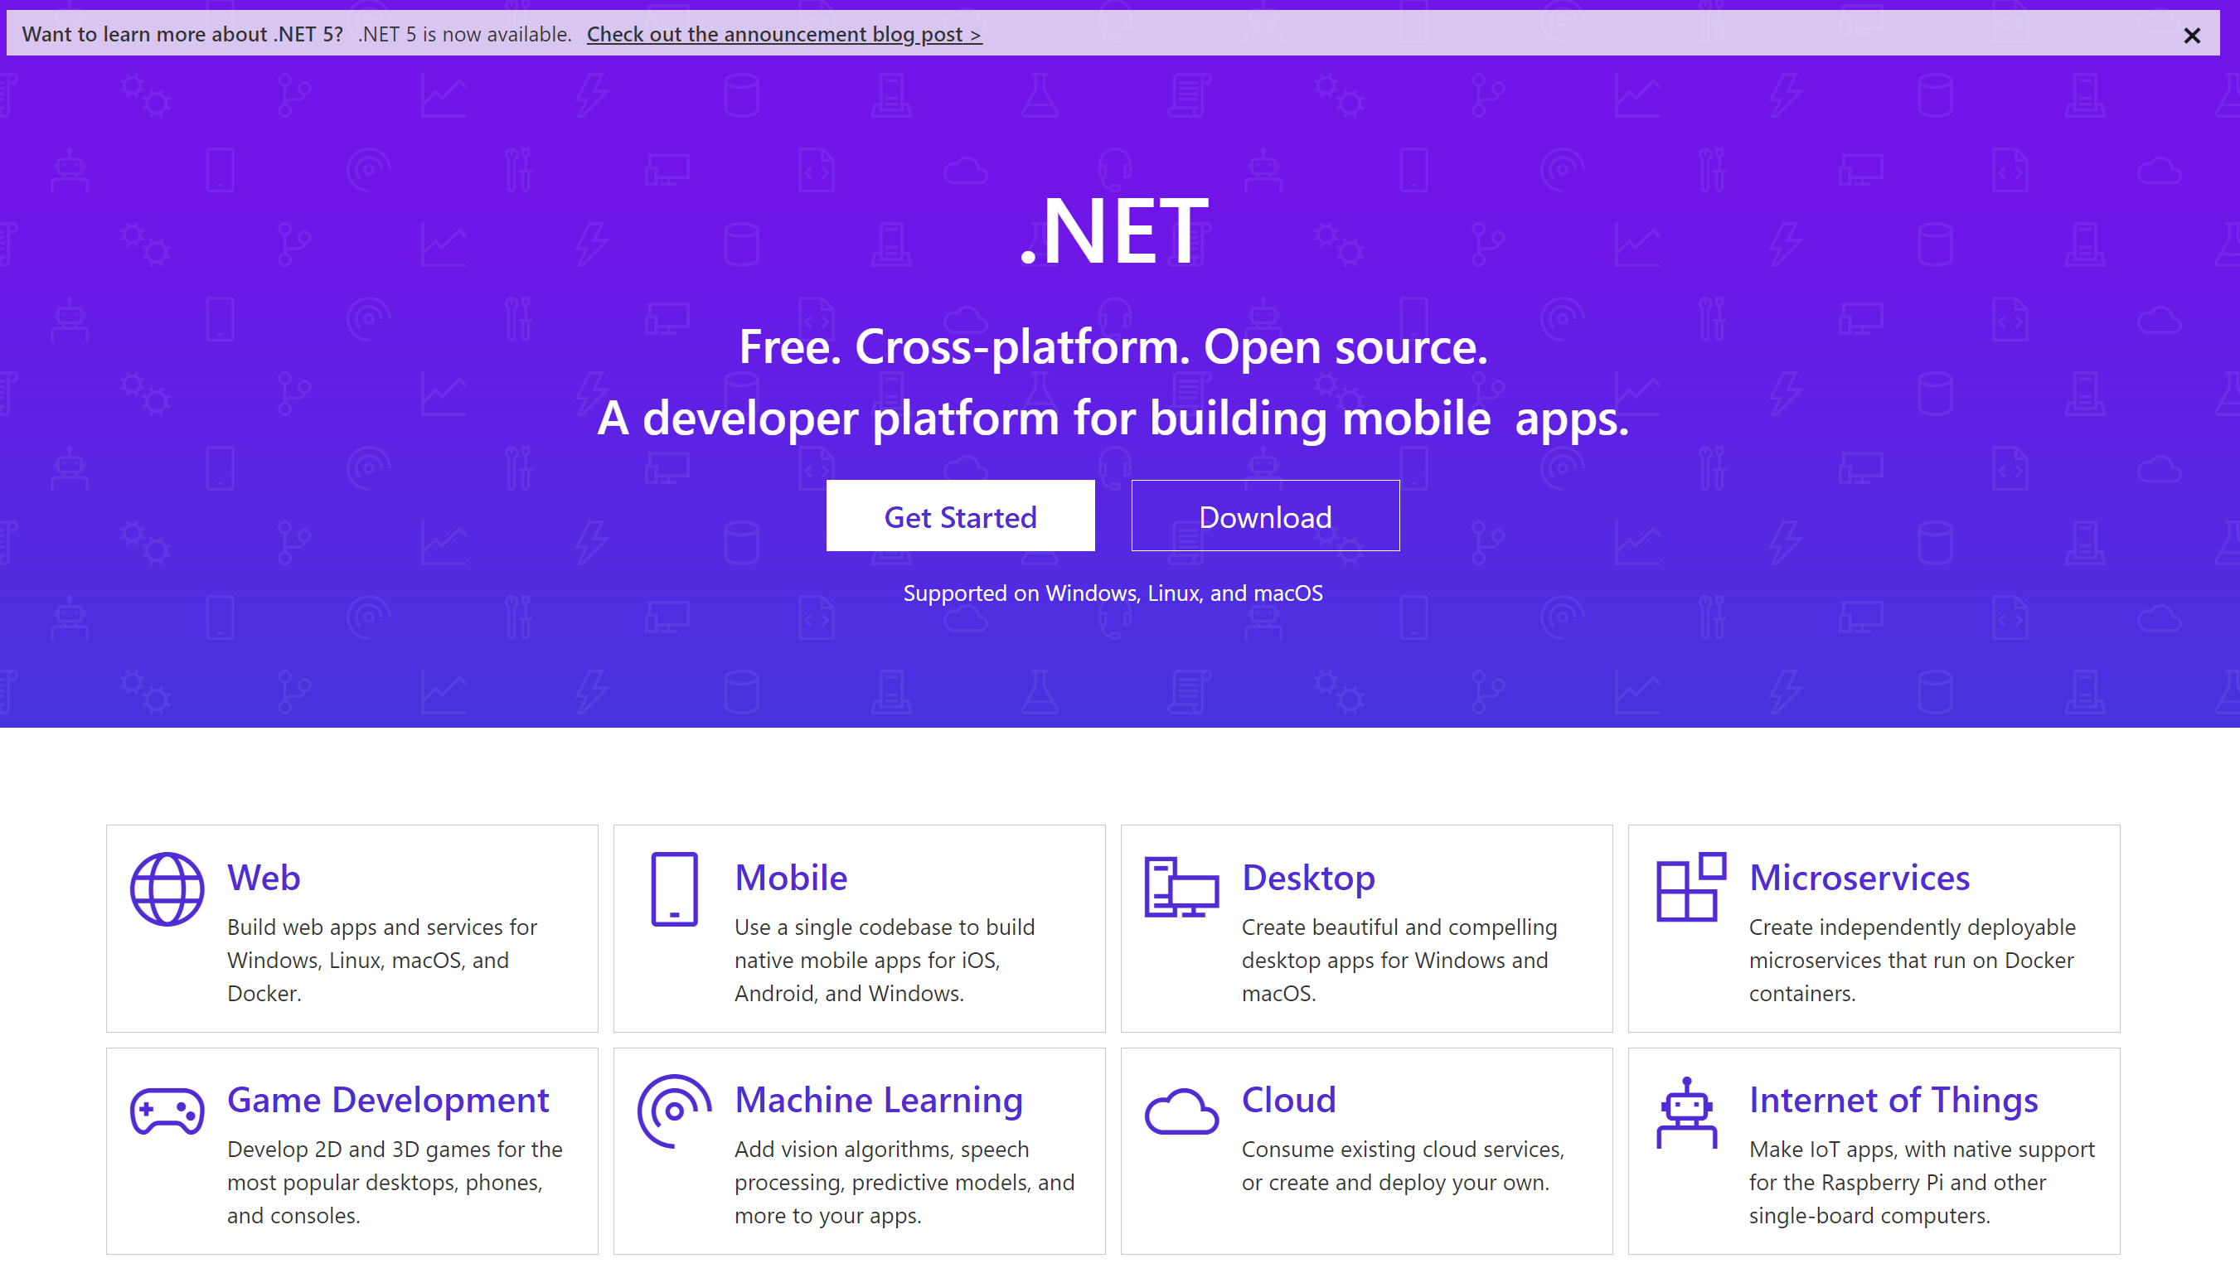
Where to start?
https://dotnet.github.io
https://dotnet.microsoft.com

Slide 16
any platform, any application, any developer

Slide 17
.NET Core is
a general purpose development platform
with cross-platform support for
Windows, macOS and Linux, various devices and cloud

Slide 18
What is .NET Core?
.NET Core is free Open Source and cross platform framework.
Originally invented for Cloud Development but:
Web,
microservices,
mobile,
desktop,
games,
AI/ML
IoT
https://github.com/dotnet/core/blob/master/release-notes/5.0/5.0-supported-os.md

Slide 19
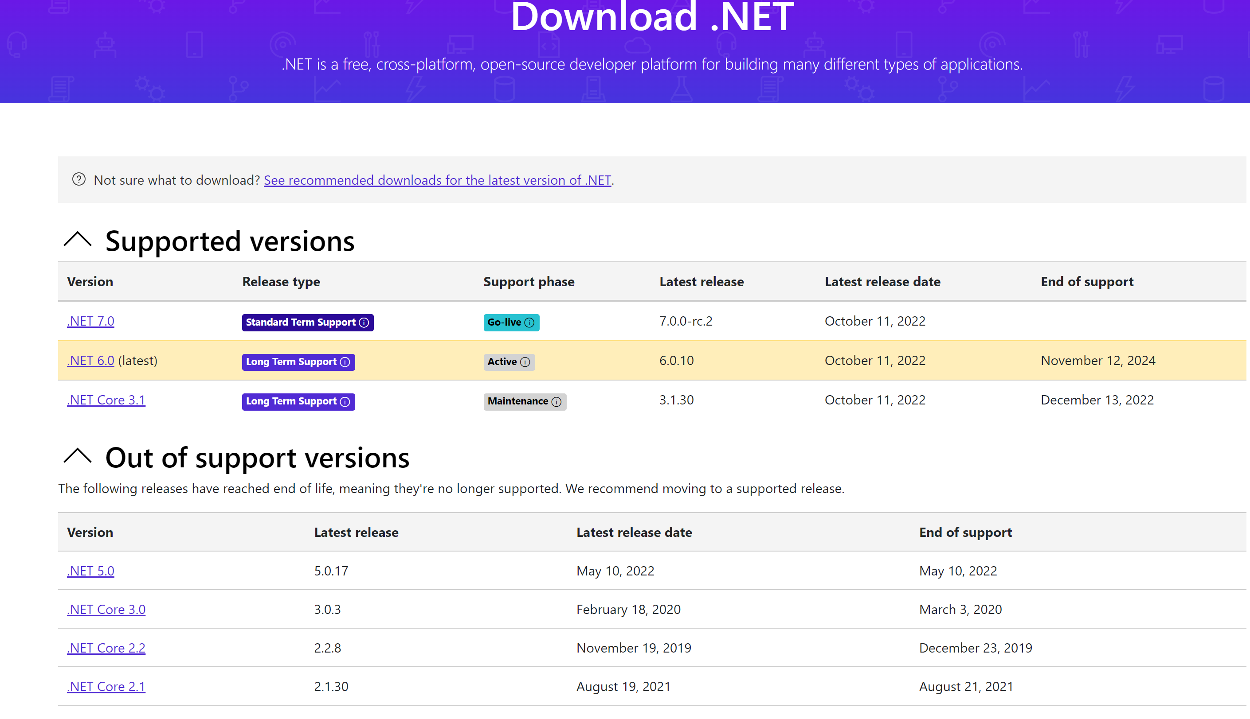
https://dotnet.microsoft.com/download/dotnet
https://dotnet.microsoft.com/platform/support/policy/dotnet-core

Slide 20






Inside of .NET Core
runtime
libraries
tools
compilers
host

Slide 21
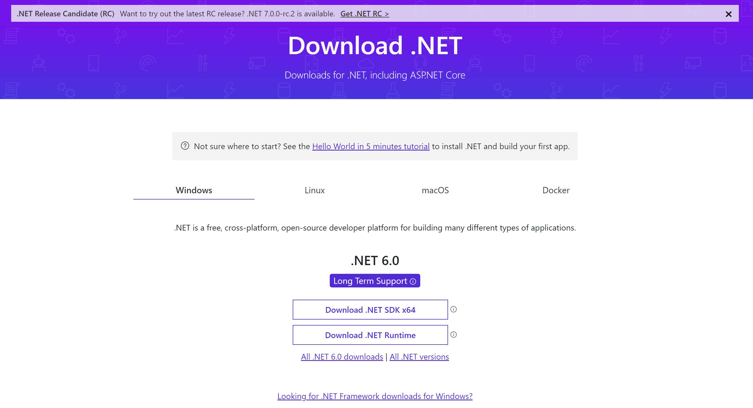
https://dotnet.microsoft.com/en-us/download
> C:\Program Files\dotnet

Slide 22
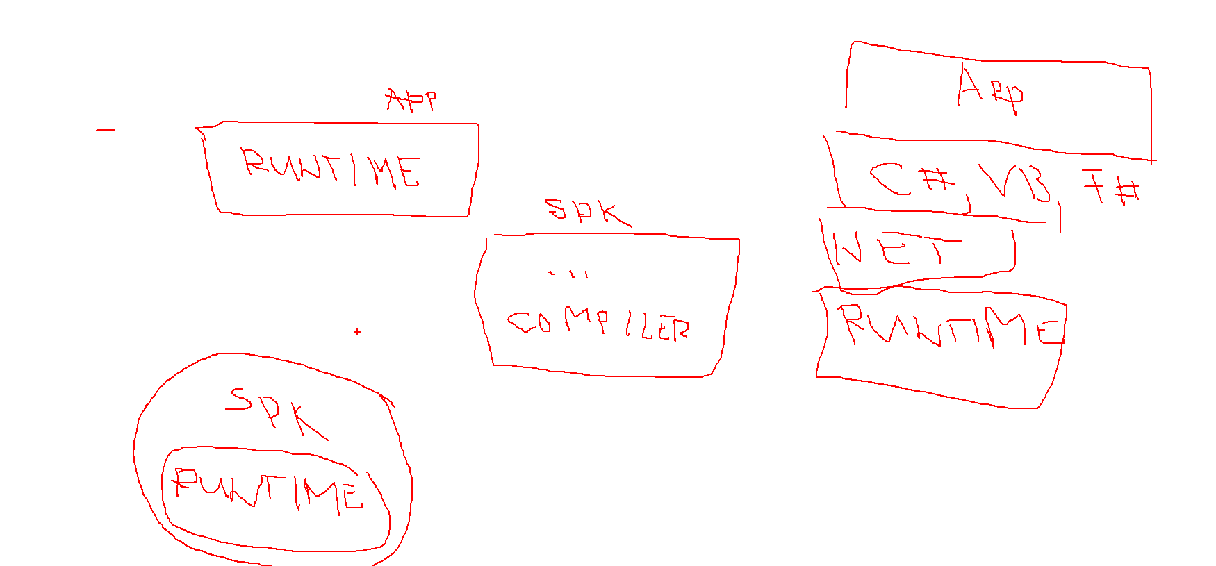
Runtime vs SDK (software development kit)

Slide 23
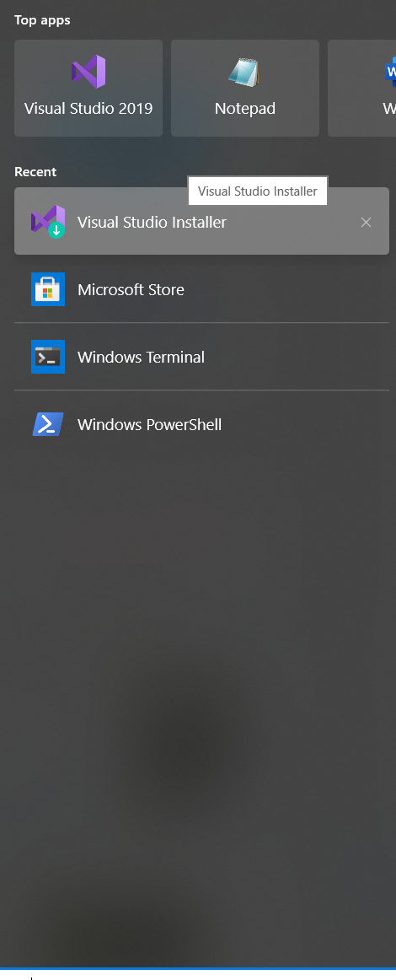
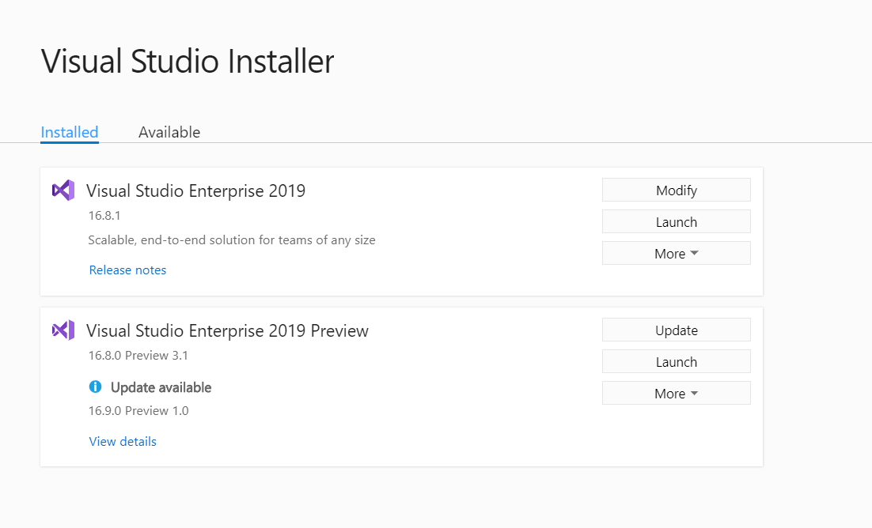
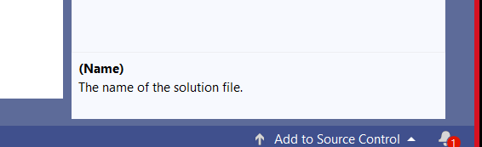
How to update Visual Studio?

Slide 24
Types of applications
Have UI
Run on the box
Need to be installed
Desktop
Application
Console
Application
Web
Application
Have NO UI
Run on the box
Need to be installed
Have UI
Run on the box in the browser
Do not need to be installed

Slide 25
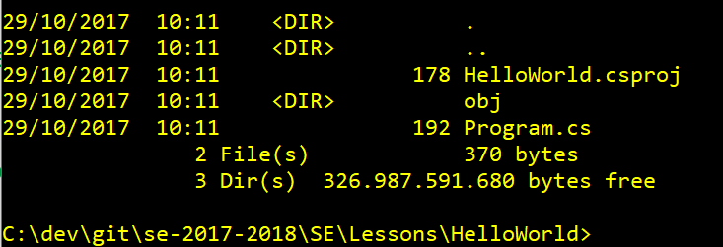
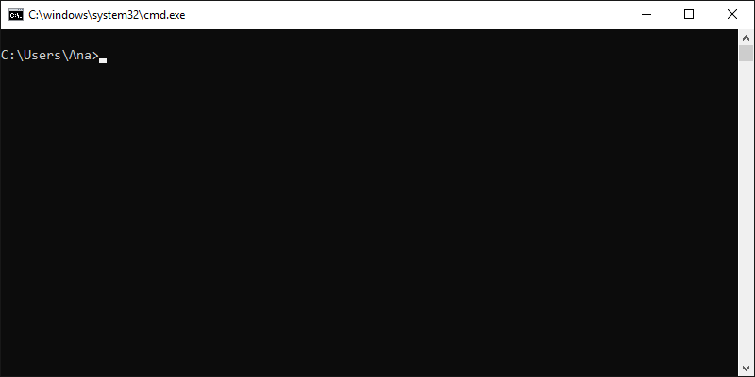
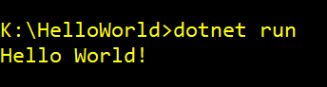
Create your first .NET Core application
//Create a new folder
mkdir YOURAPP
// Go to folder
cd YOURAPP
// Create a new .NET Core project
dotnet new console
// Create a new .NET Core project
dotnet restore
// Build the project
Dotnet build
// Run application
dotnet run
https://dotnet.microsoft.com/learn/dotnet/hello-world-tutorial/create

Slide 26
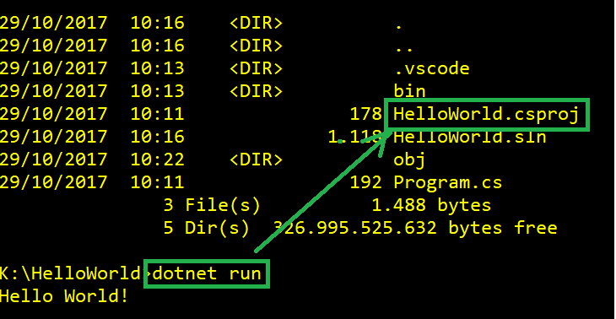
Running build
If you have a source code and command prompt is in folder which contains project file csproj, then you cas simply use dotnet run.

Slide 27
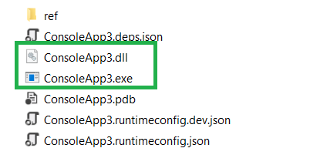
Running application without “csproj”
.NET Core application is a DLL (Dynamic Link Library)
dotnet ConsoleApp3.dll
ConsoleApp3.exe

Slide 28
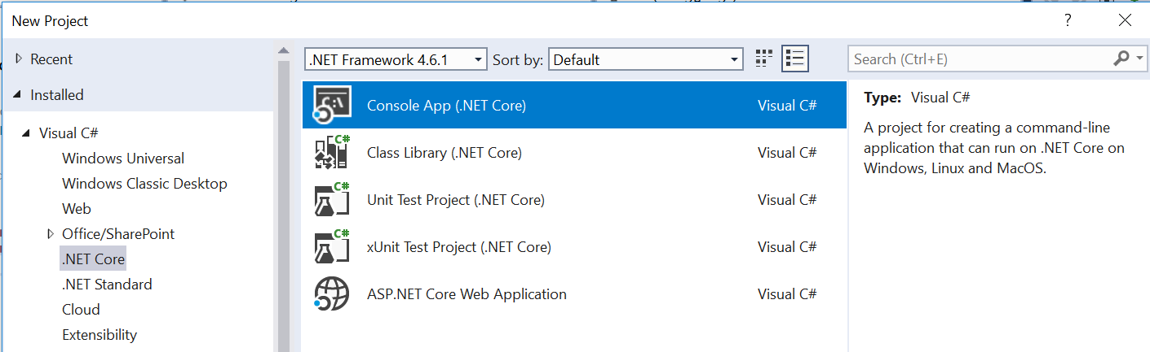
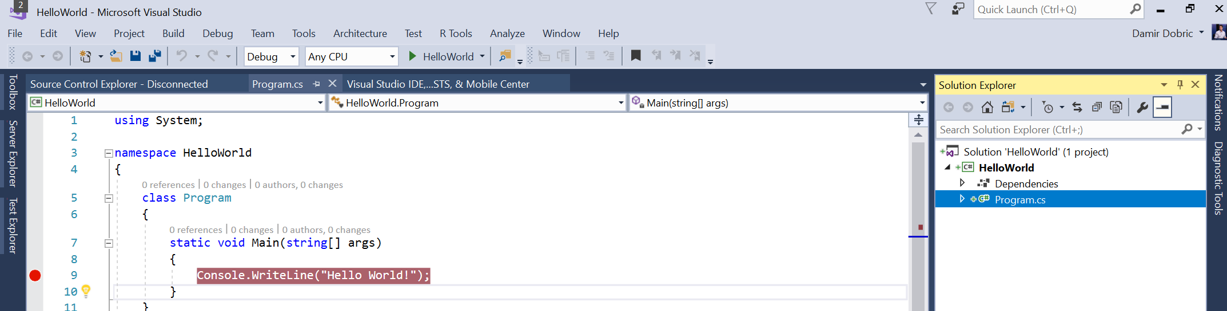
Create an application with Visual Studio

Slide 29
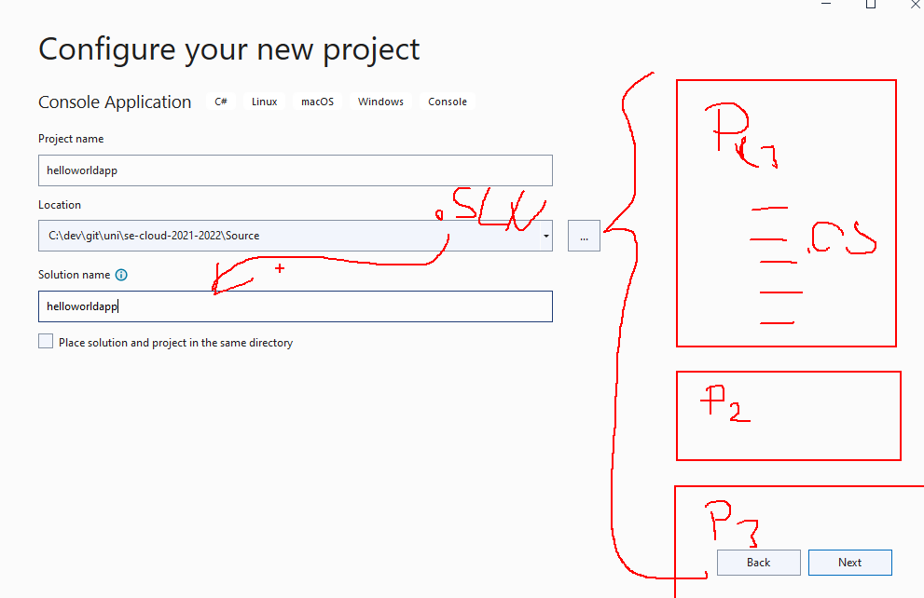
Projects and Solutions

Slide 30
Exercises
E1 - Install .NET5 (you can install VS)
E2 - Create your first program with command line
E3 - Create your first program with Visual Studio
E4 – Learn about Structure of Application.
.NET In-Browser Tutorial - Step 1: Intro (microsoft.com)

Slide 31
(E1) Install VS & .NET Core SDK
The best way to develop with .NET Core on Windows is using Visual Studio. We will work in course with this version.
You can alternatively use download Visual Studio Code.
Download .NET 6.0 SDK (don’t need if VS installed) https://www.microsoft.com/net/download/core
For Linux friends https://docs.microsoft.com/en-us/dotnet/core/install/linux-ubuntu#2004-
C:\Users\YOURUSERNAME\AppData\Local\Packages\CanonicalGroupLimited.Ubuntu20.04onWindows_79rhkp1fndgsc\LocalState\rootfs\home\YOURUSERNAME

Slide 32
(E2)Create a project with command line
//Create a new folder
mkdir YOURAPP
// Go to folder
cd YOURAPP
// Create a new .NET Core project
dotnet new
// Create a new .NET Core project
dotnet restore
// Build the project
dotnet build
// Run application
dotnet run

Slide 33
(E3)Create Application in VS
In Solution Explorer, open the context menu for the Console Application (.NET Core) project. Name it "App", and set some the location. .
Open the Program.cs and paste following code:
Set a breakpoint after the line that you just added.
Press F5 to run the application..
The application should build without error and should hit the breakpoint.
using System;
namespace ConsoleApplication
{
public class Program
{
public static void Main(string[] args)
{
Console.WriteLine("Hello World!");
}
}
}

Slide 34
(E4)Structure of App & Reading Files
The basics of the .NET Core Command Line Interface (CLI).
The structure of a C# Console Application.
Reading from File
Writing output to console
The basics of the Task Asynchronous Programming Model in .NET Core.
https://docs.microsoft.com/en-us/dotnet/articles/csharp/tutorials/console-teleprompter

Slide 35
Exercises
???

